Slide 1



Information Systems
Development of an Integrated Registration and Monitoring System for MEDLINE Clinic Management with Automated Reporting
Bachelor Paper
Turgunov Adhamjon
Supervisor: Dr.sc,ing., Profesor, Jelena Caiko
April 2026

Slide 2


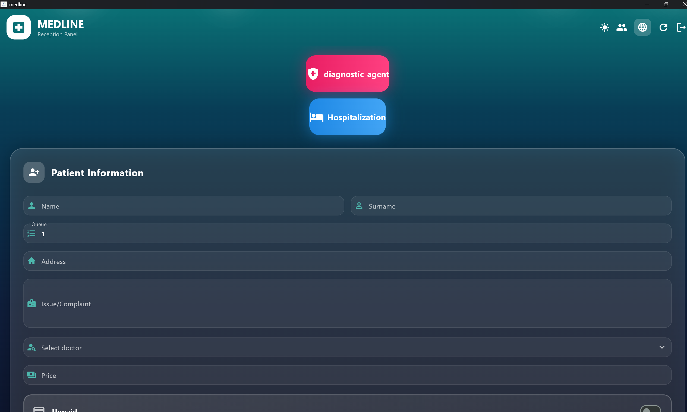
Problem Statement
Many clinics still lack a centralized patient database. A significant number of healthcare institutions continue to rely on traditional paper-based record systems, which require considerable time, physical storage space, and human resources.

Slide 3
Thesis Objective
Topic: Development and Implementation of a Hospital Information System
Proposed Solution: Transition from paper-based documentation to a fully digital system that integrates all departments (doctors, pharmacy, laboratory) into a unified platform.
Enhancements: Implementation of role-based access control and customizable user interfaces.
Future Work: Integration of advanced statistical analysis, reporting modules, and scalability for use in other medical institutions.

Slide 4
Methodology
The following approaches were used to address the problem:
Development of a cross-platform mobile application using Flutter
Data storage and user management through Firebase
Implementation of role-based access control for different departments
Replacement of traditional paper records with a digital system

Slide 5
Hypothesis
If a clinic management system is developed using Flutter and Firebase, then a unified codebase can effectively support patient registration, department monitoring, and automated reporting across Android, iOS, and Web platforms.

Slide 6
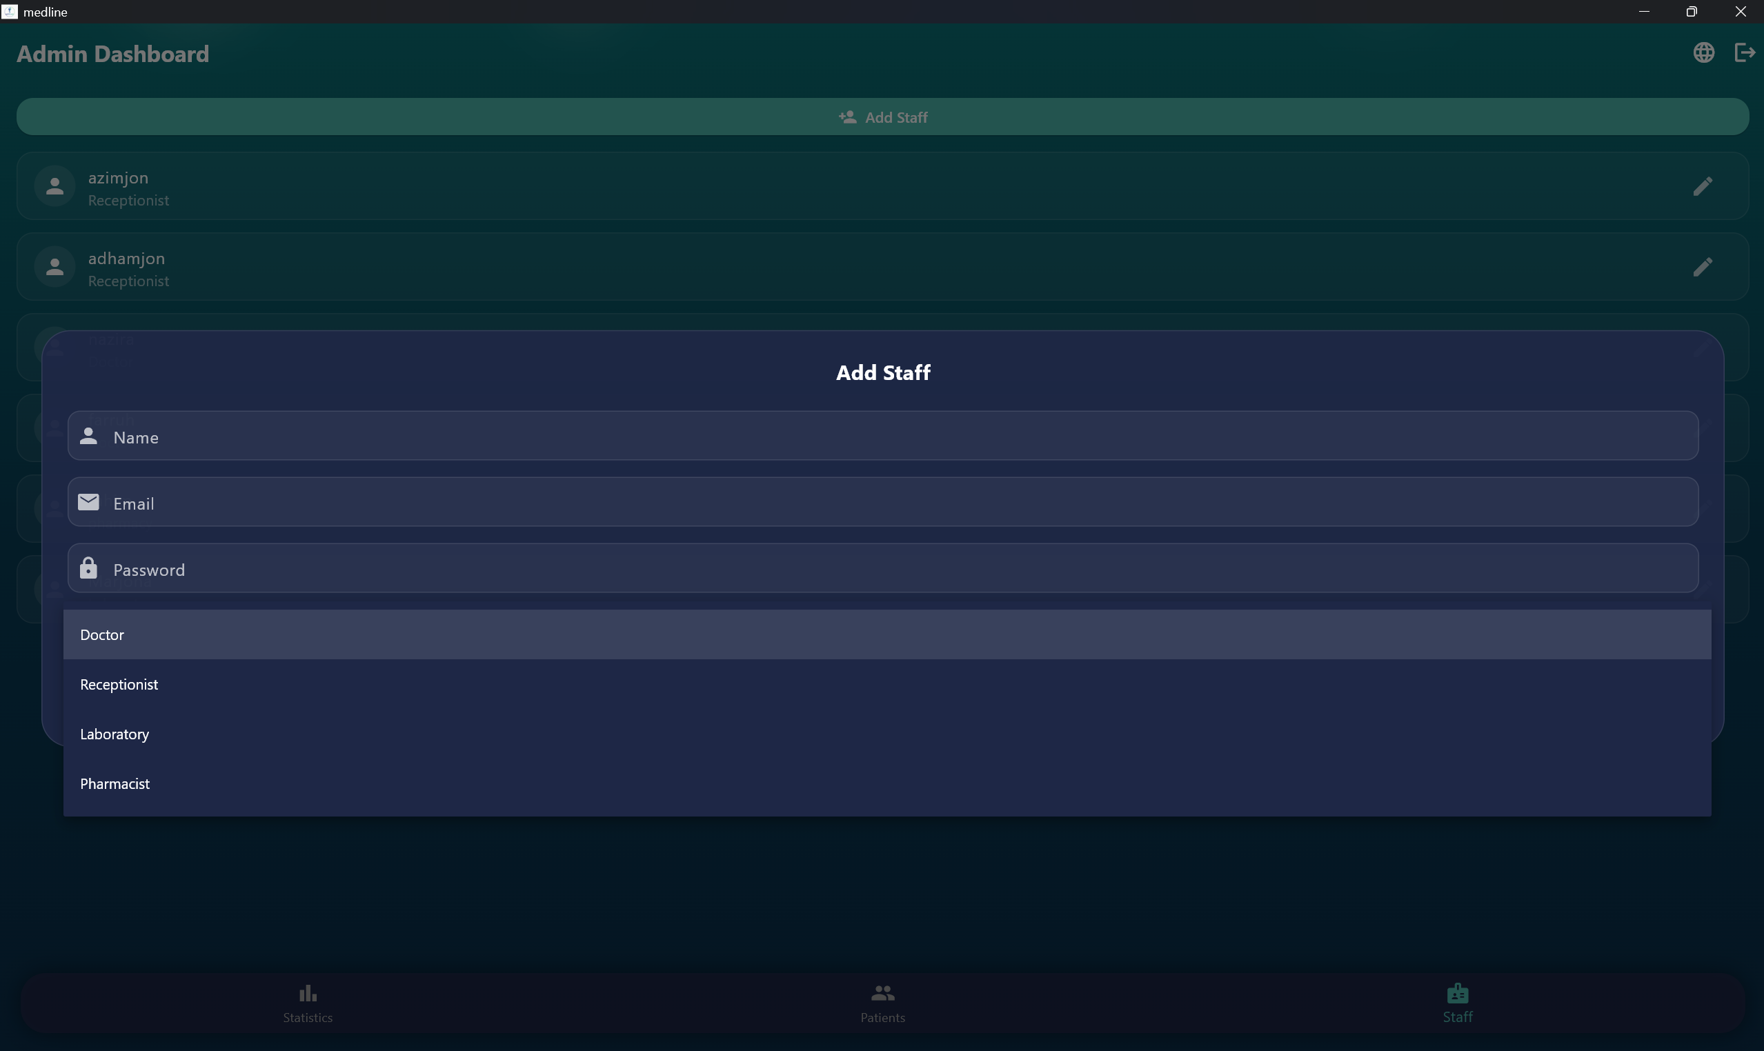
Proposed Solution:
A modern mobile application called MEDLINE was developed using contemporary programming technologies.
Each department (doctor, pharmacy, laboratory) is assigned specific access rights
Patient records are stored digitally instead of using paper-based registers
The system ensures efficient data management and secure access control

Slide 7
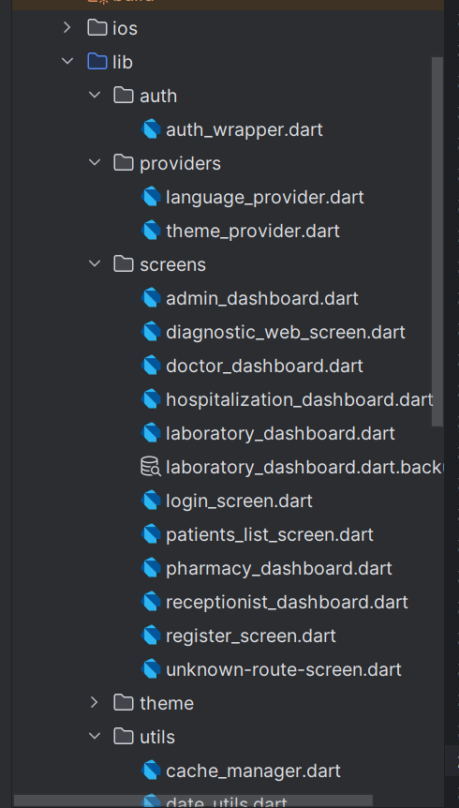
Testing Levels:
The system was tested at multiple levels:
Unit Testing – Individual functions such as authentication and data storage were tested
Integration Testing – Interactions between system components (doctor, pharmacy, laboratory) were verified
System Testing – The entire system was evaluated as a complete unit
User Acceptance Testing – End-users (admin, doctors, pharmacists) tested the system in real-world scenarios

Slide 8
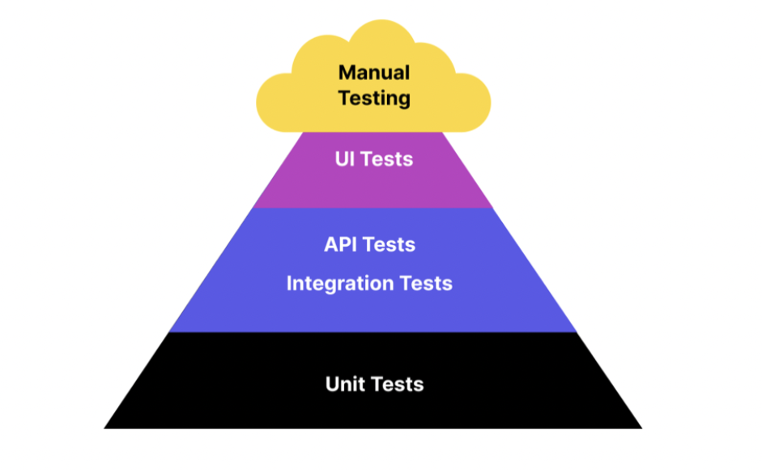
Software Testing Methods:
1.Black Box Testing — The system performance was checked from the user's side
2.White Box Testing — The internal structure and logic of the code was checked
3.Manual Testing — Each screen and function was tested manually
4.Automated Testing — Repetitive processes were checked automatically

Slide 9
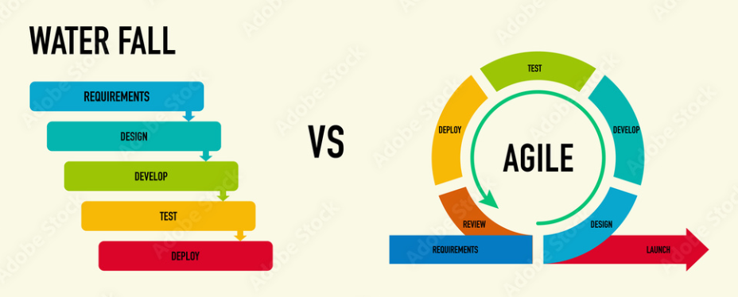
Software Development Methodologies:
1.Waterfall — The project was developed step by step
2.Agile — The project was developed quickly by dividing into small parts
3.Scrum — The system was developed based on sprint plans

Slide 10
Conclusion
The MEDLINE hospital management system was successfully designed and implemented.
The system:
Digitizes all hospital departments
Eliminates the need for paper-based records
Improves efficiency in patient management
Enhances data security through role-based access control
Overall, the solution demonstrates the effectiveness of modern technologies in optimizing healthcare management processes.

Slide 11
Thank you!

